Slide 1

WELCOME

Slide 2

Institute of Aeronautical Engineering
(Autonomous)
Department of Electronics and Communication Engineering
Topic : Dual-Band Planar Monopole Antenna for
WLAN/Wi-Fi Application
By :
19951A04M6 – Mettu Vishnu Vardhan.
.
Supervisor Name
Professor:
Dr. V Padmanabha Reddy.
Electronics and Communication Engineering
Assistant professor:
Dr. D Srikar.
Electronics and Communication Engineering

Slide 3
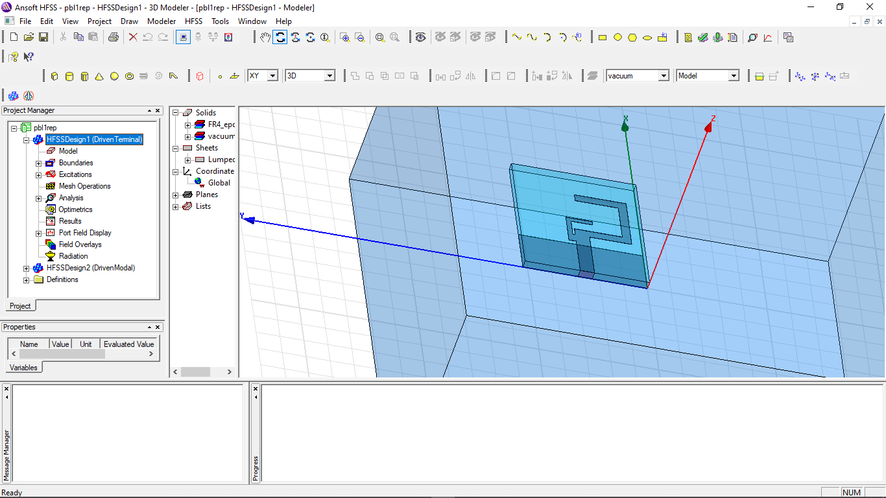
Introduction:
The present antenna which we are going to design has an greater use in WLAN/Wi-Fi Applications.
As the range of (WLAN) Wireless local area network and (Wi-Fi) Wireless fidelity communication systems lies in the range of 2.4/5.2/5.8 – GHz
So we are going to design an antenna using (HFSS)High Frequency Structured Simulation Software.

Slide 4
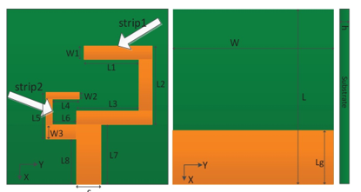
Abstract :
The proposed planar monopole antenna with dual band character for WLAM/Wi-Fi application.
This can obtain the impedance bandwidth of 2.3-2.9 and 4.70-5.90 GHz with s11 less than -10d.
The total dimension of the antenna is 30 x 26 mm^{2.} This antenna was printed on the substrate of FR-4 with two “C” – shaped strips and a microstrip feed line on the front side and the grounded plane on the flip side.
As the resonant bands of this antenna are excited by different strips, the resonant frequency in different bands could be flexibly tuned with little effect on the other.
The results between the experiment and simulated one are agree well, great impedance matching and good gain are obtained.
The details of the analysis of them are discussed below.

Slide 5
Literature Survey:
All the antenna’s which were surveyed, numerous monopole antenna’s have been proposed because of size reduction, bandwidth enhancement, and resonance-mode realization, etc. For example, Compact planar inverted ”F” antenna is presented in [1],[2], and coplanar waveguide (CPW)-fed antennas with inverted L-Strip in [3].
They all cover WLAN operation band, but the structure of PIFA needs a big ground plane, while the CPW-fed structure has low gains and narrow impedance matching band. Furthermore, some antennas exhibit complex structure [6]-[8].
So far, the best antenna presents a dual-band ‘CP’ Planar Monopole Antenna for WLAN/Wi-Fi application. The antenna has a compact and simple structure with total size of just 40 x47x1.5 mm³.The radiator is composed of ‘2’ parts. A” C” shaped strip here was mainly used for obtaining a good impedance match and CP performance in lower band.
The proposed antenna had a measure of (-10dB) impedance bandwidth for 380 MHz and a 3-dB axial ratio (AR) bandwidth for 1240 MHz and a 3-d AR bandwidth of 870 MHz the overlapped impedance and AR bandwidth can cover 5.2/5.8-GHz WLAN bands and the simulated and results measured are focused in the further discussions.

Slide 6
Existing method :
In this paper, Dual Band Planar Monopole Antenna with the dimension of 30 x 26mm²
Is presented for WLAN (2.4-2.485 GHz/5.15-5.35 GHz/5.725 – 5.825 GHz), and also for Wi-Fi (2.412 - 2.472/5.15-5.85 GHz) application. Although the “L” shaped strip was initially proposed in [9],
The “C” shaped strip on the left of the radiator is used for producing resonance at upper band, and the length of the strip is approximately a quarter wavelength at its operating frequency.
The “L” shaped stirp on the right side at the radiator is mainly used for producing resonance in the lower band, which is approximately a quarter-wavelength. Geometric parameter’s of this antenna were listed at Table-1.
The antenna optimization and design are carried by using this commercial software called High Frequency Structure Simulator- (HFSS).

Slide 7

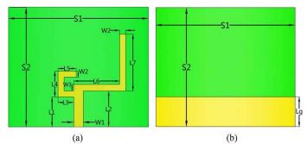
Existed Antenna :

Slide 8
Problem defined :
In this existed antenna it had few disadvantages like lower gain, lower impedance matching, lower current intensity.
This can overcome by introducing another “C” shaped strip on the left side of the antenna. This “C” shaped strip in place of “L” shaped strip helps in increasing the Impedance matching and increasing current intensity.
So, the two “C” shaped strips bridged together to perform better than the existed antenna.

Slide 9
Proposed Antenna:
Parameter | L | W | L1 | L2 | L3 | L4 | L5 | L6
Value(mm) | 26 | 26 | 9 | 12.5 | 10 | 4.5 | 7 | 3.5
Parameter | L7 | L8 | Lg | W1 | W2 | W3 | S | h
Value(mm) | 11 | 9 | 10 | 1.8 | 1 | 2 | 3 | 1.6

Slide 10
Software Used :
To perform the discussed antenna results or to observed the result of this designed antenna we used “(H.F.S.S) High Frequency Structured Simulation”.
HFSS will used to get all the types of results such as Frequency plots, gain plots, both discrete and in sweep type. Basically, this HFSS interface has an 3D geometrical interface with X, Y, Z Co-ordinate Axis, where we can build or construct antenna using all the 3D objects.
After a successful construction of this antenna we can analyze all the parameters and we can find the results for it. Following shows the interface of this software and the image of this Antenna that we proposed in it

Slide 11
Results and Discussions:
Besides, then length of ground plane also effects characteristics of the antenna.
It was clear that there was a severe effect on the performance of the antenna by Lg. Not only the upper resonant band is shifted as it changes, but the value of S-11 is affected within the both resonant bands.
Though it is hard to explain the exact rule of the impact by Lg, the resonant band is changed when Lg gets smaller or bigger.
After the successful preformation of designed antenna the frequency plots for different L1, L4 lengths will be as follows.

Slide 12
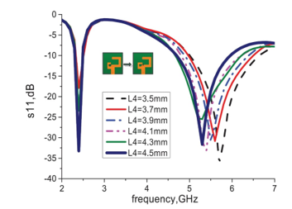
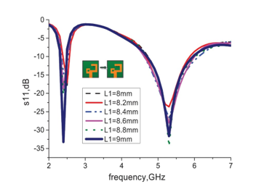
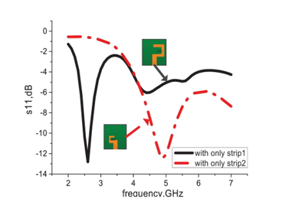
Results :

Slide 13
Conclusion:
This presentation, The Dual Band Monopole Antenna at this compact size and simple structure is proposed.
The “C” shaped radiation strips on the substrate play a important role for achieving the resonant bands that could cover all the 2.4/5.2/5.8 -GHz WLAN bands and all the 2.4/5.5-GHz Wi-Fi bands.
The measured -10dB impedance bandwidths are 190 MHz at the lower band and 1200 MHz at the upper band. From the measured and simulated results, we can conclude that this antenna had many advantages like good impedance matching at both lower band and upper band of WLAN/Wi-Fi, wide resonant bands, independent radiation strips and stable gains.
Glad we have perfectly utilized the HFSS software.

Slide 14
References:
[1] Moon, J.I., Sim, D.U., and Park, S.O.: “Compact PIFA for 2.4=5 GHz dual ISM-band applications”,
Electron, Lett., Vol. 40, no. 14, pp. 642̢ 643, 2004.
[2] P. W. Chan, H. Wong, and E. K. N. Yung Wideband planar inverted antenna with meandering
Shorting strip, Electron. Lett Vol. 44, no. 6, pp. 395̢396, 2008.
[3] T.H. Kim and D.C. Park, ĀCPW- fed compact monopole antenna for dual-band WLAN applications, ā
Electron. Lett., vol. 41, no. 6, pp. 291 ̢293, 2005.
[4] C. -M. Wu, Dual-band CPW fed cross-slot monopole antenna for WLAN operation, ā IET Micro.
Antennas Protag., vol. 1, no.2, pp. 542̢546, 2007.
[5] C. Wang, Z.-H. Yan, P. Xu, J.-B. Jiang and B. Li, Trident-shaped dual-band CPW-fed monopole
antenna for PCS/WLAN applications ,ā Electron. Lett., vol. 47, no. 4, pp. 231̢232, 2011.
[6] Chun-Cheng Lin, En-Zo Yu, and Chih-Yu Huang, Ā Dual-Band Rhombus Slot Antenna Fed by CPW
for WLAN Applications ,āIEEE Antennas Wireless Propag. Lett., vol. 11, pp. 362̢364, 2012
[7] Y. Xu, Y.-C. Jiao and Y.-C. Luan, Ā Compact CPW-fed printed monopole antenna with triple-band
characteristics for WLAN/WiMAX applications, āElectron. Lett., vol. 48, no. 24, pp. 1519̢1520, 2012.
[8] M. Naser-Moghadasi, R. Sadeghzadeh, L. Asadpor, and B. S. Virdee, ͆A Small Dual-Band CPW-Fed
Monopole Antenna for GSM and WLAN Applications ,͇IEEE Antennas Wireless Propag. Lett., vol. 12,
pp. 508̽511, 2013.
[9] Symeon Nikolaou, Photos Vryonides and Dimitrios E. Anagnostou, ͆Dual-band Microstrip-Fed
Monopole on RO4003 Substrate ,͇2008 IEEE ,Antennas & Propagation Society International
Symposium., vol. 10, pp. 1̽4, 2008.

Slide 15
THANK YOU

